Slide 1
Methodology Research
Chaotic Dynamical Systems

Slide 2
Example system
Lornez 96
Variables per timer step: 256
Reduced number of used variables: 8
Data set of 1 million timesteps
Other systems potentially to be added
KS system
…

Slide 3
Tested models
ESN (Echo State Networks)
Model input: 8 variables of one data point
Model warm um: 3 consecutive known initial conditions
Training length 300000, radius 0.1, degree 3, sigma 0.5, beta 0.0001, size 5000
LSTM (Long Short-Term Memory – Keras)
Model input: 2D array of 3x8 variables
Training length 300000, hidden nodes 250, epochs 1000, batch size: 72

Slide 4
Experiments
Model training
Trained on data from 1st to 300000th data point
Trained on data from 300000th to 600000th data point
Executing prediction
Initial conditions are 25000 data points starting from 950000th
For each initial condition 1000 time-steps are predicted
Analysis:
Understanding prediction result for each model
Comparing predictions from tweaked ESN and LSTM models

Slide 5
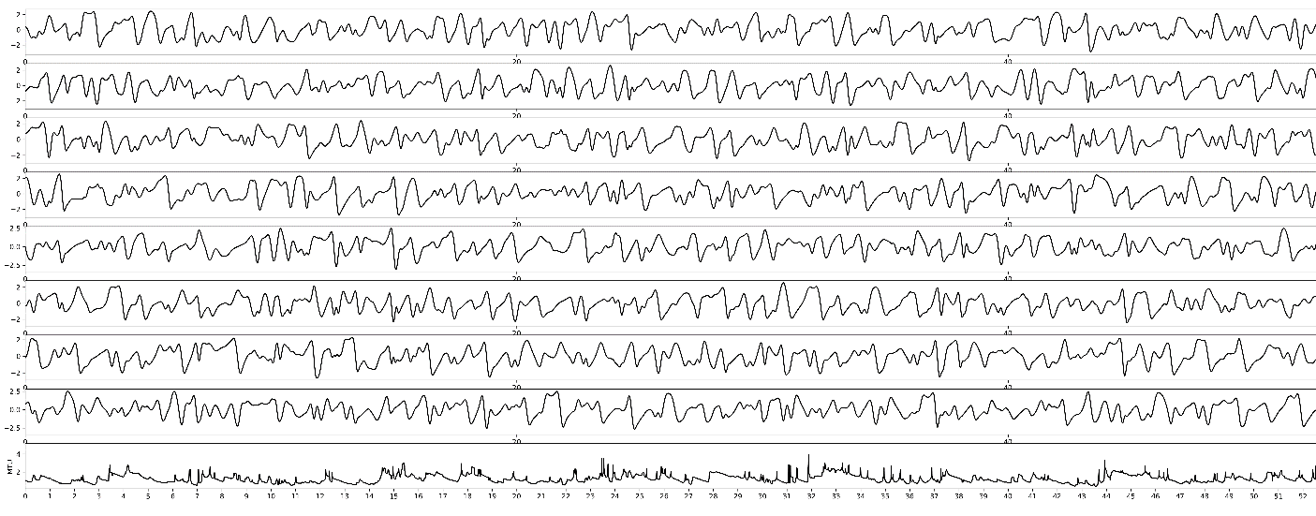
Prediction horizon
Length of useful prediction before it diverges from validation data
Original data
Horizon

Slide 6
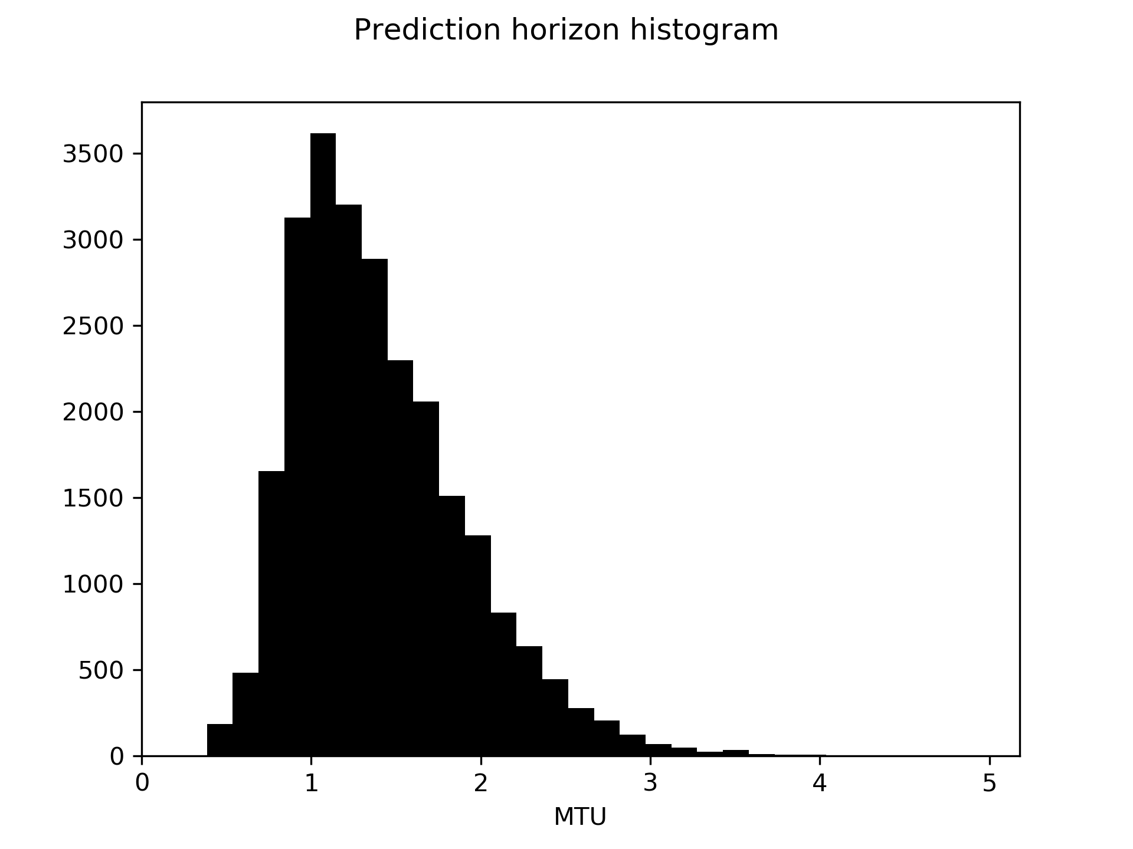
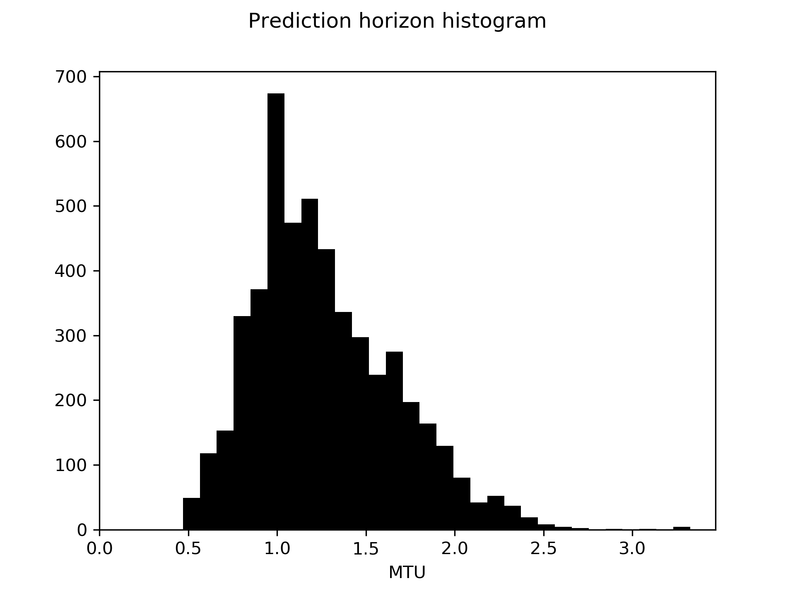
Prediction horizon histogram
Validation set
(data from outside training set)
Data from inside training set
(no overfitting)
Number of examples
Number of examples
Prediction horizon
Prediction horizon

Slide 7
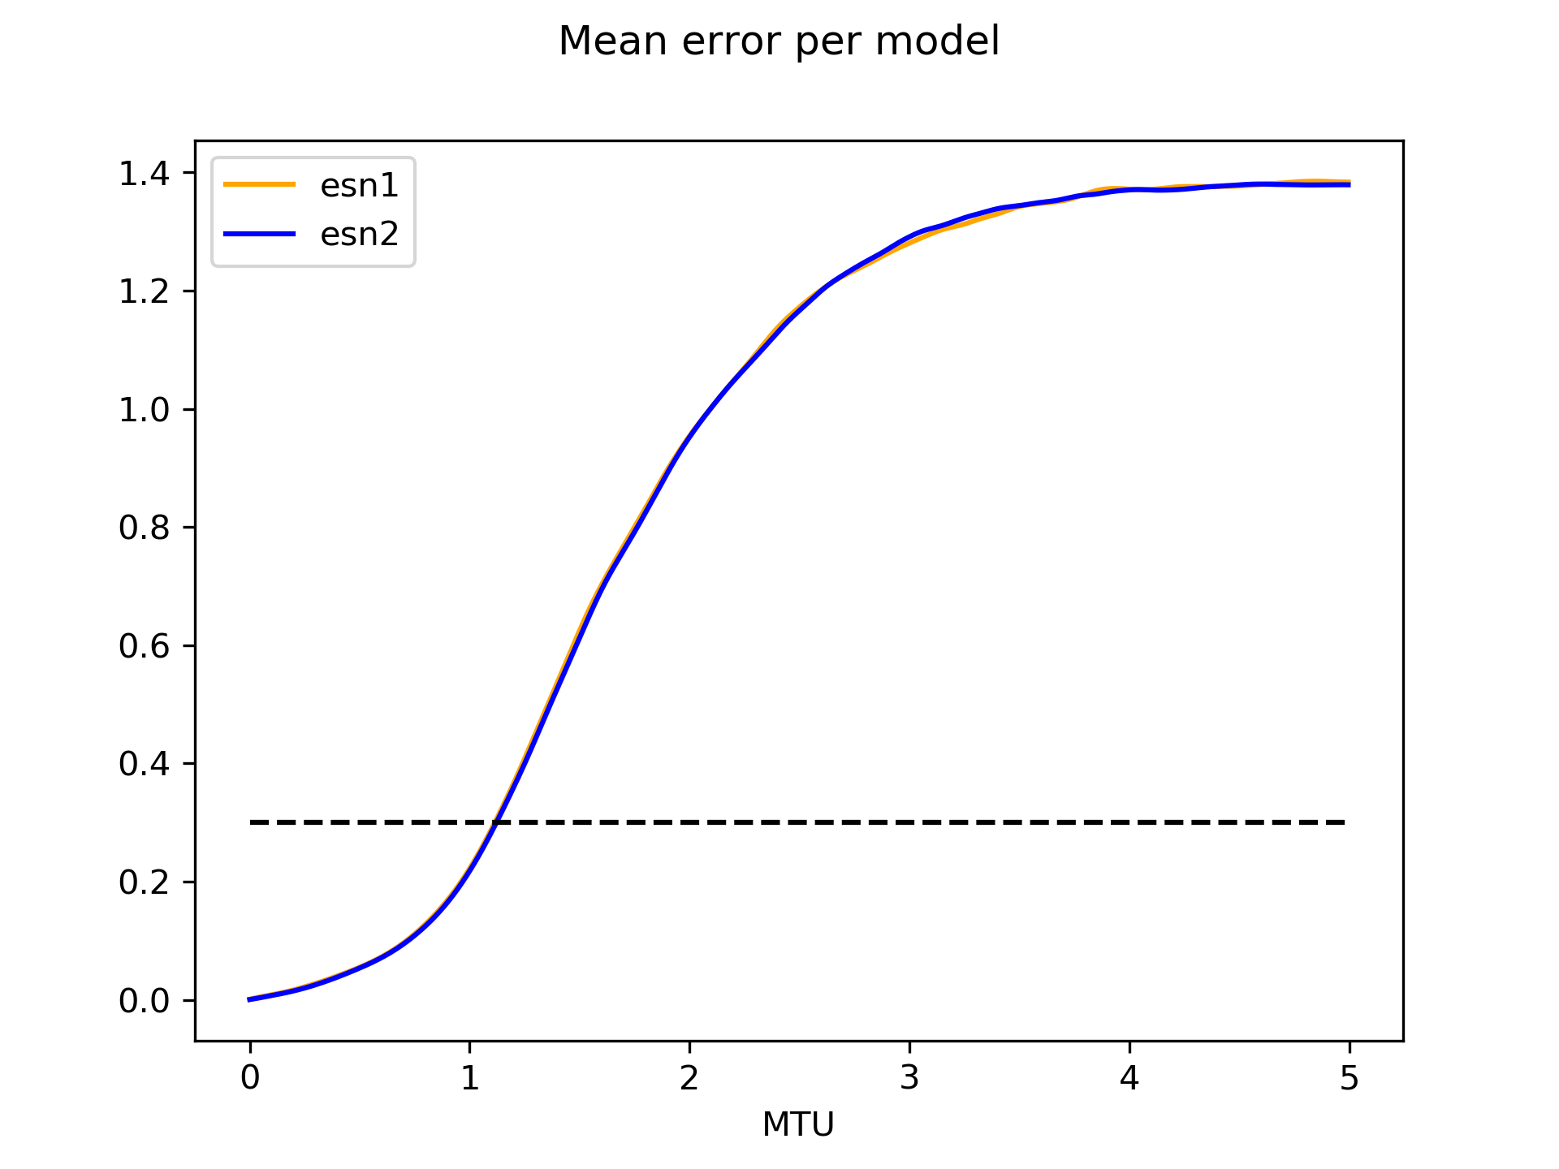
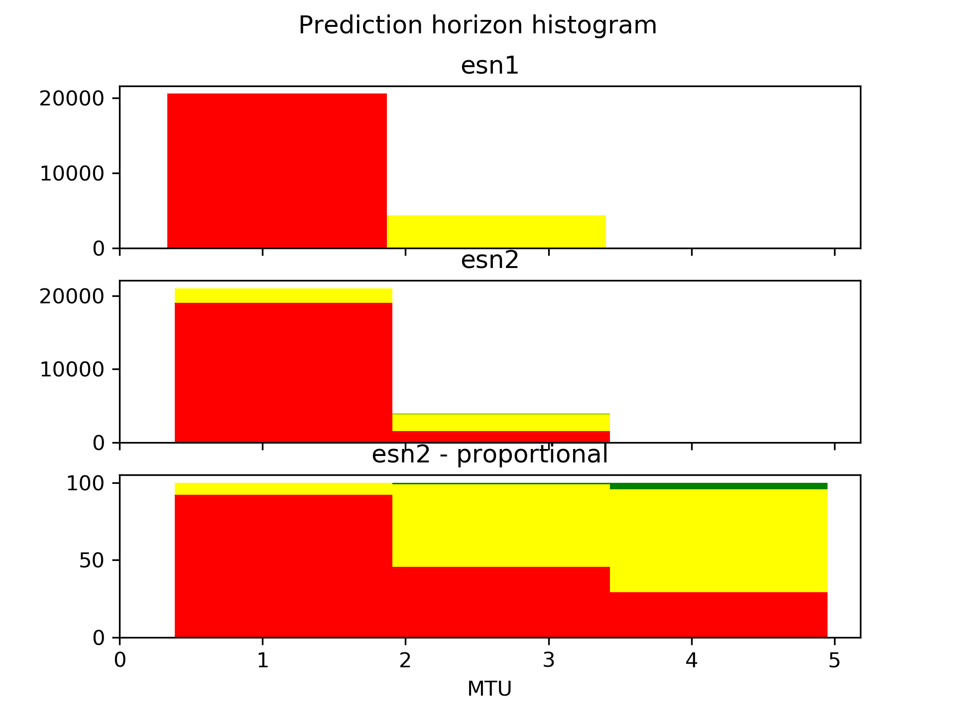
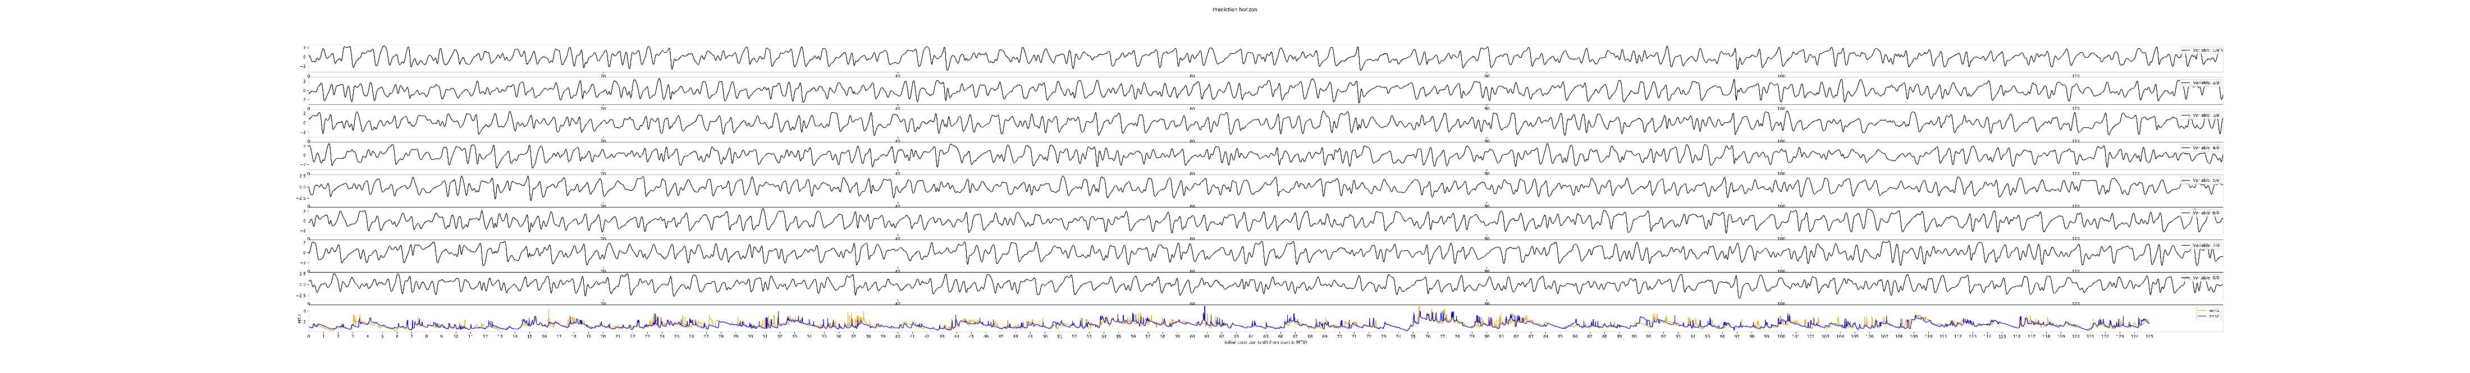
Comparing ESN-s with different seeds
Number of examples
L2 norm error
Prediction steps
Prediction steps

Slide 8
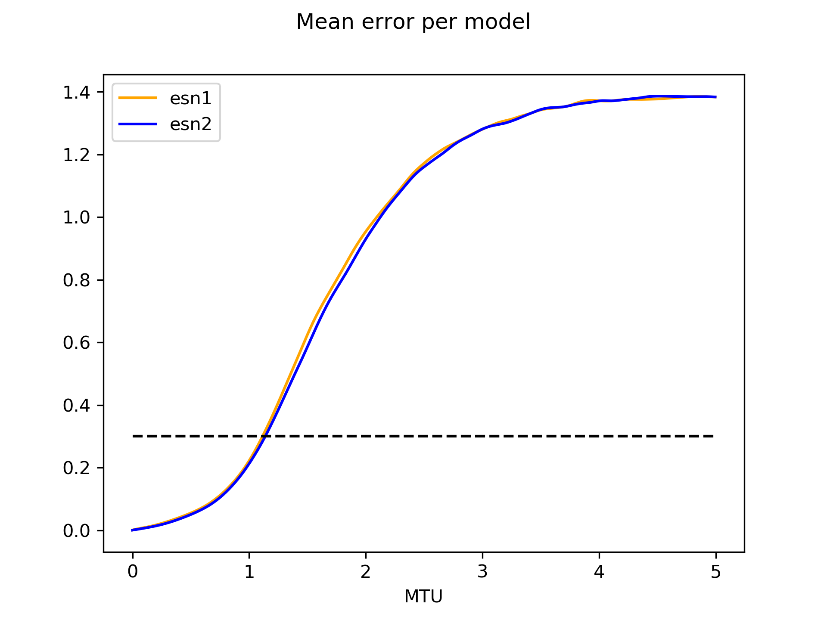
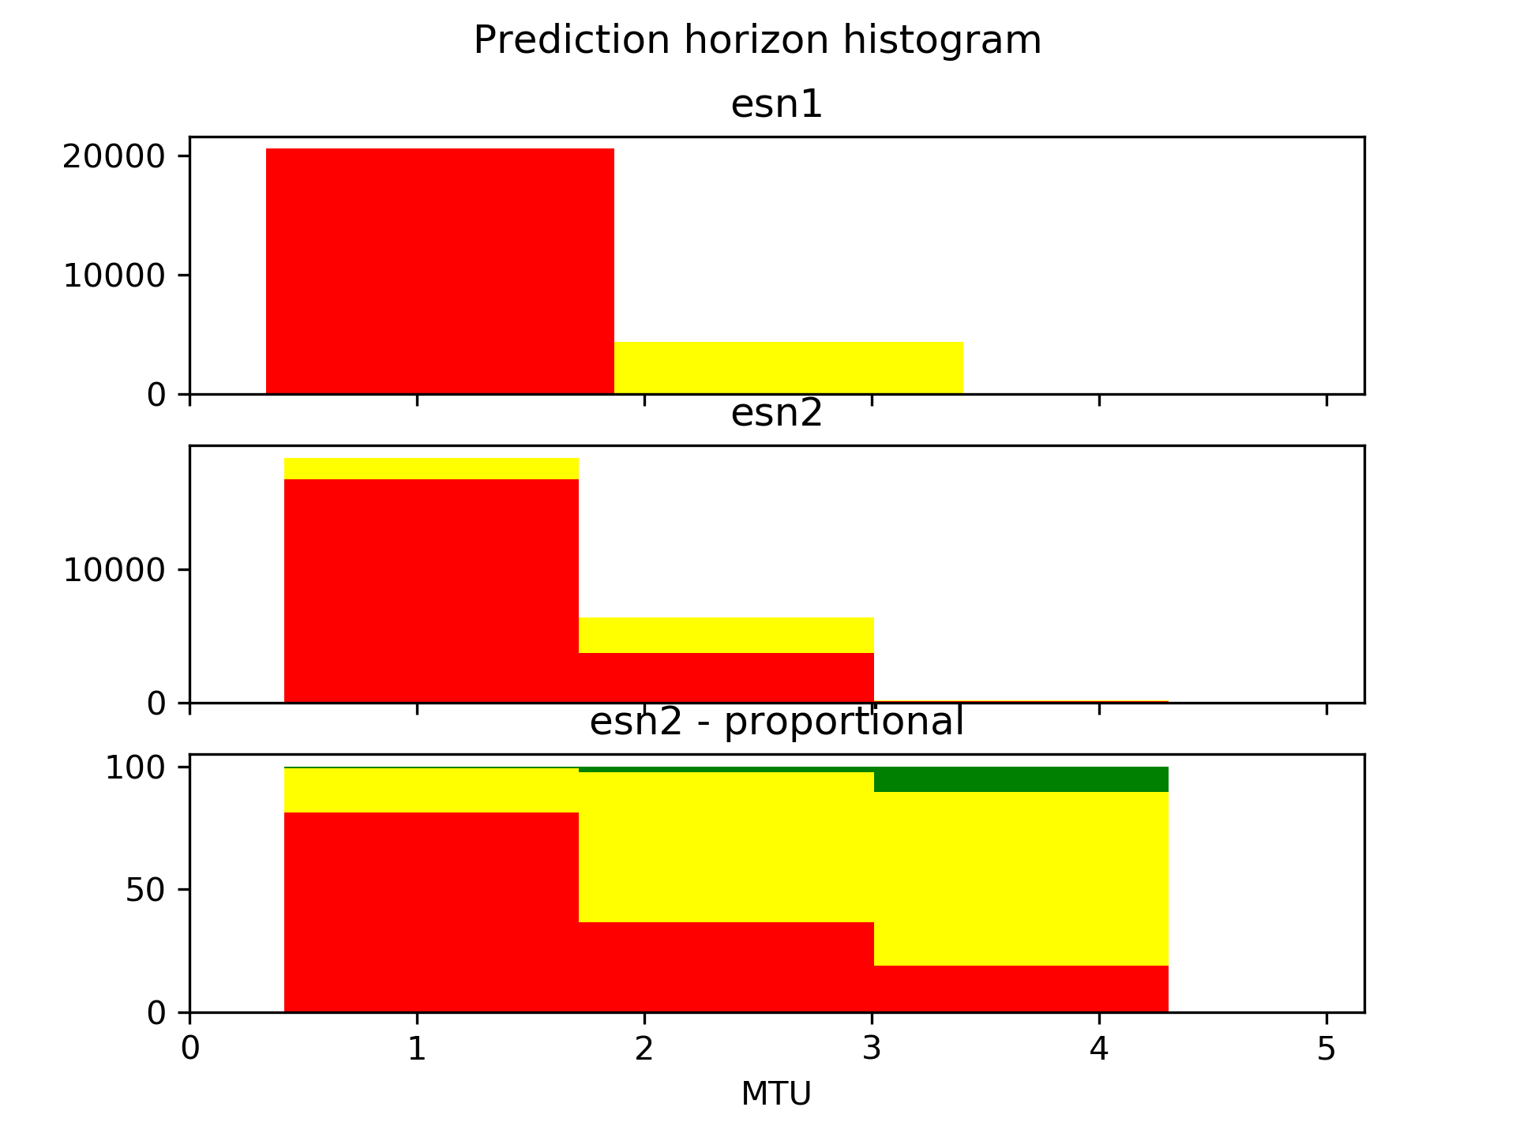
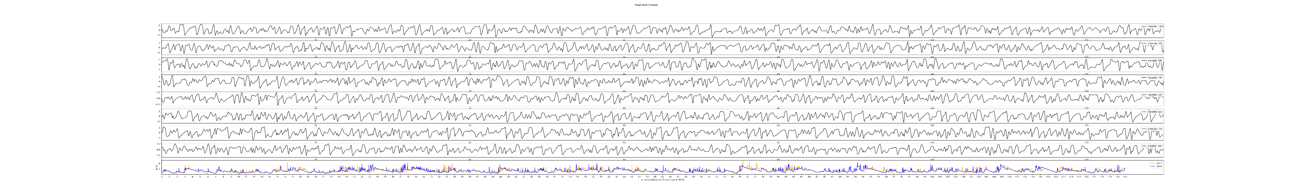
Comparing ESN-s with different training data
Number of examples
L2 norm error
Prediction steps
Prediction steps

Slide 9
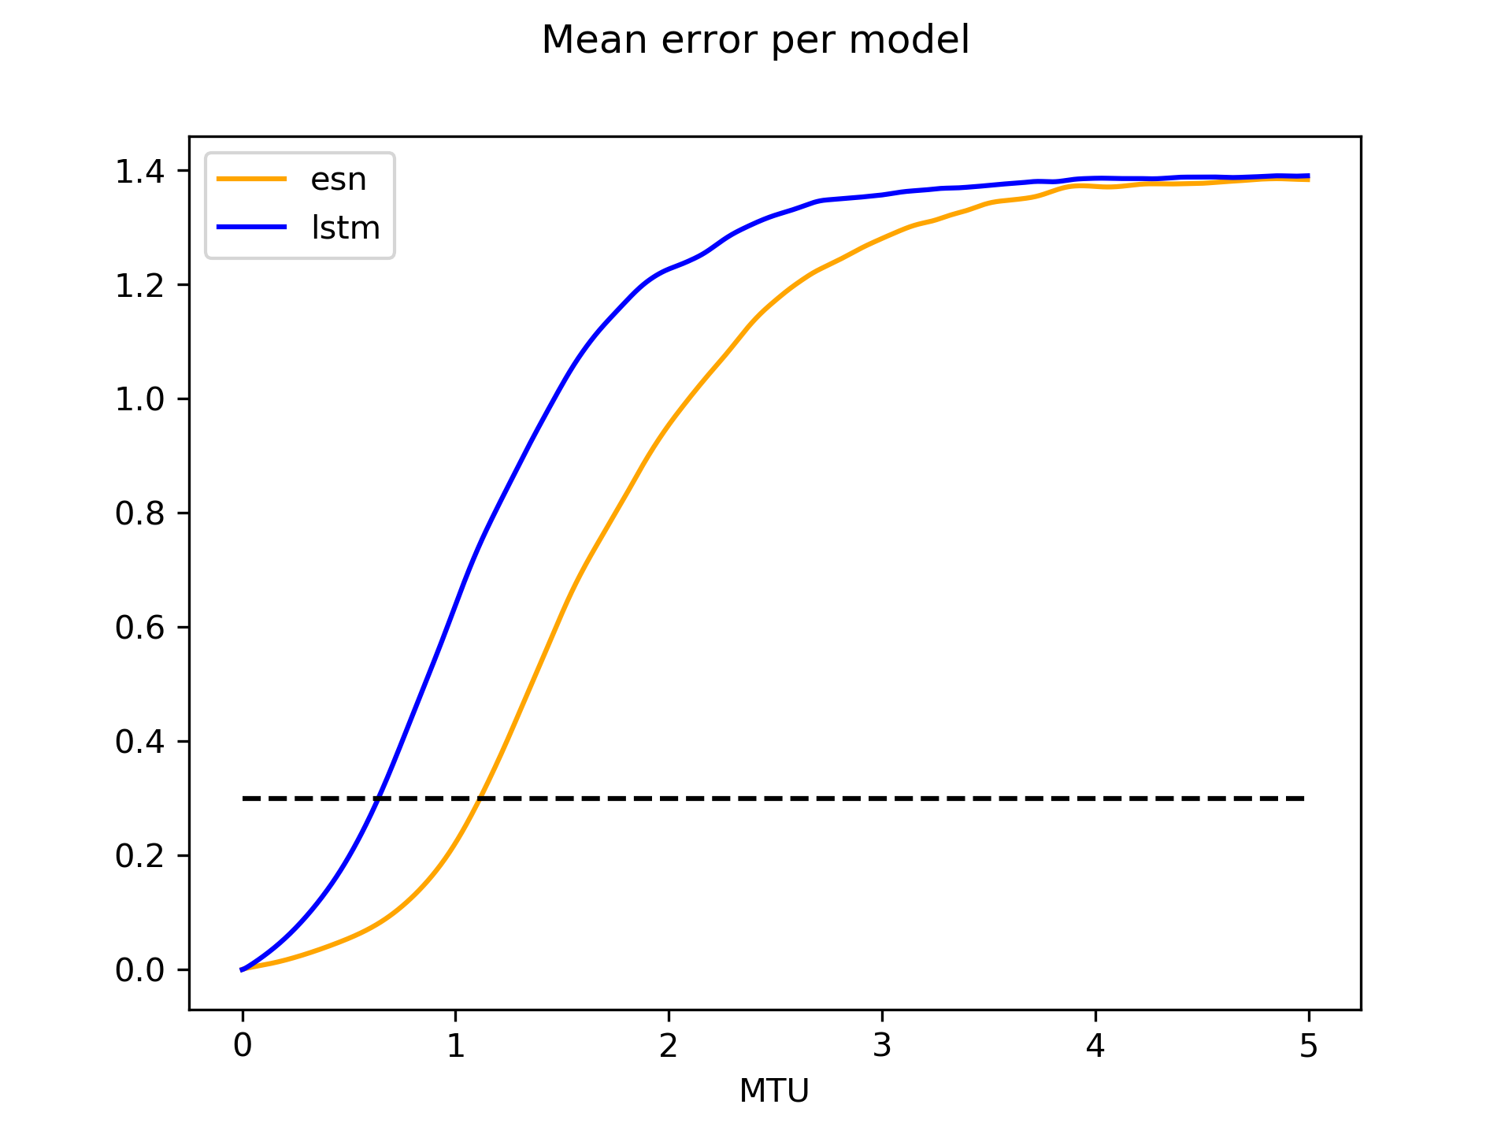
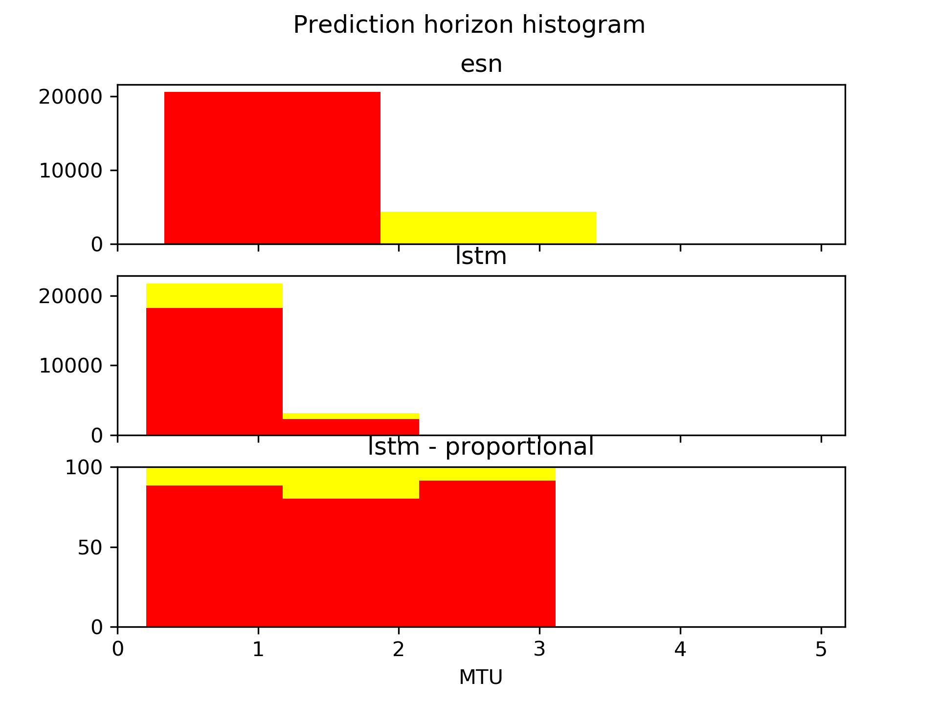
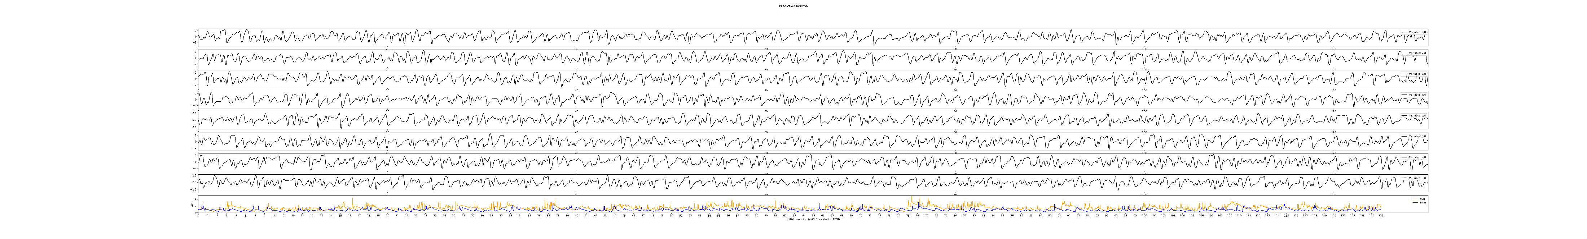
Comparing ESN and LSTM
Number of examples
L2 norm error
Prediction steps
Prediction steps

Slide 10
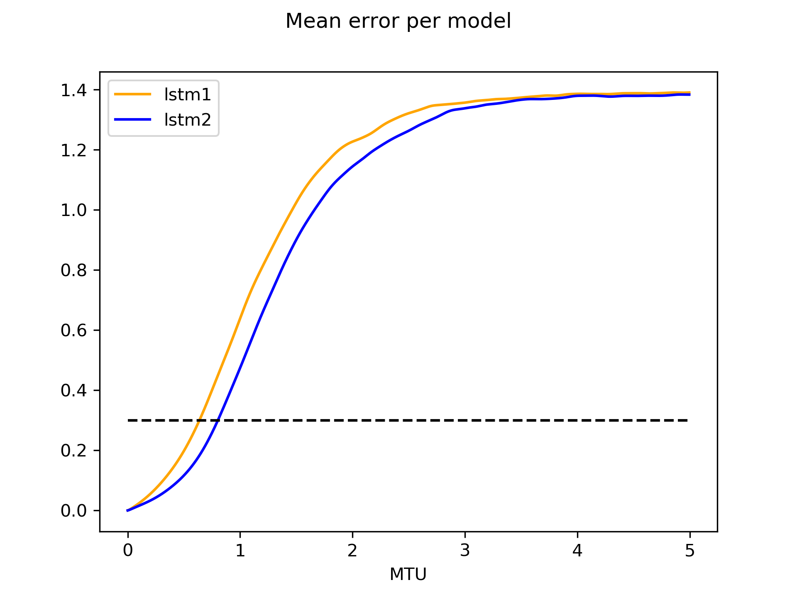
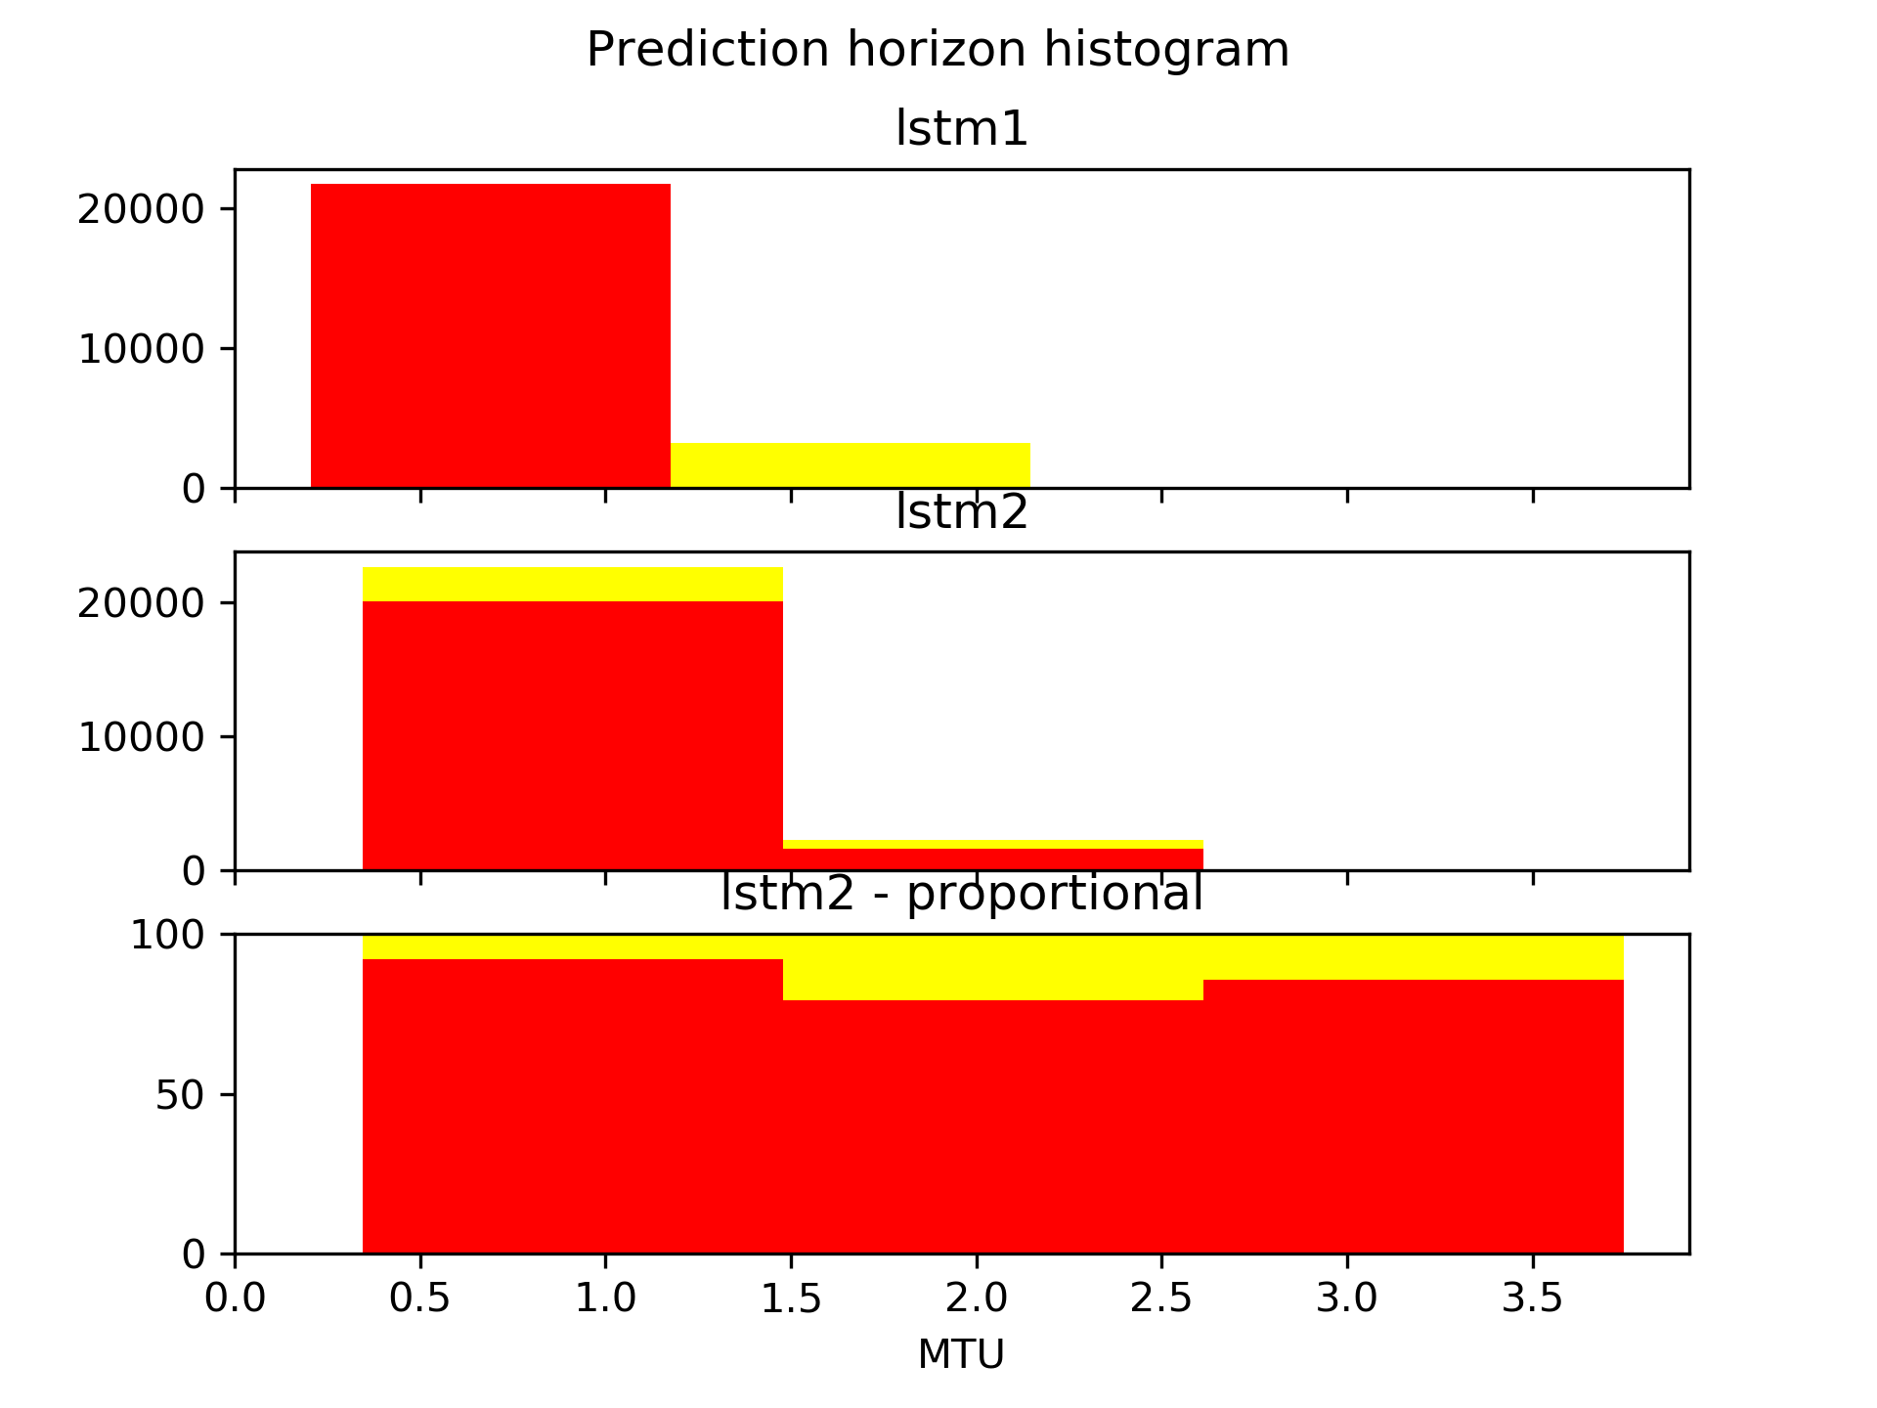
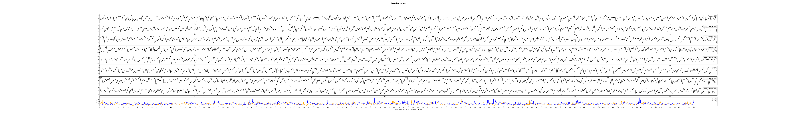
Comparing LSTM-s with different training data
Number of examples
L2 norm error
Prediction steps
Prediction steps

Slide 11
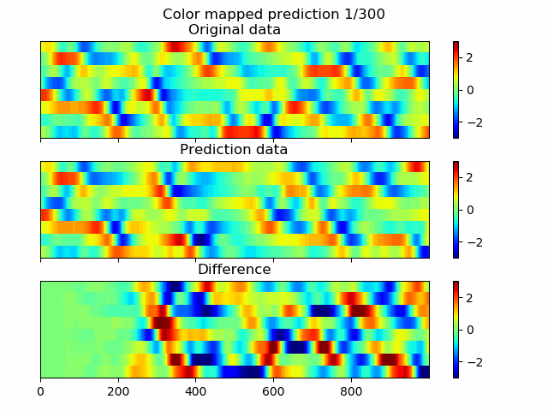
Consecutive ESN prediction animation
Variables 1-8
Prediction length

